Slide 1

NEIL GOGTE INSTITUTE OF TECHNOLOGY
Computer Science and Engineering
Advanced Personal Finance Tracking
and Analysis Platform
Kanchu Navyateja
Gangula Venkata Raja Vineela
Gunti Sai Pranitha
245322733154
245322733143
245322733148
Under the Guidance of
Dr.M.Mahendar
Assistant Professor, CSE

Slide 2
INTRODUCTION
1. Efficient Financial Management
The Finance Tracker automates the process of recording income, expenses, and transactions. It reduces the time, errors, and effort involved in traditional manual tracking. With a user-friendly interface, it makes personal finance management simple and accessible.
2. Improved Financial Awareness
Users gain real-time insights into their spending habits and income flow. The system helps identify unnecessary expenses and areas for improvement. Interactive dashboards and visual reports make financial data easy to understand.
3. Budgeting and Financial Stability
The system allows users to set budgets, track their progress, and manage savings. It sends alerts for overspending, encouraging disciplined financial behavior. By promoting planning and awareness, it supports long-term financial goals and stability.

Slide 3
LITERATURE REVIEW
Aishwarya & Hemalatha (2024) – ML-based system predicting expenses using transaction data with visual analytics.
Prof. Sushma A et al. (2025) – Django web app for income, expense, and savings tracking with reports.
Tihomir Stefanov et al. (2024) – Android app for budgeting, financial reporting, and visual tracking.
Lavesh Lingayat et al. (2024) – Real-time ML tracker with expense prediction and behavioural analysis.
Samar Verma et al. (2024) – Web-based tool for modern financial planning and management.
Yu Xie (2016) – Android app with voice assistance, charting, and accessibility features.
S. Busk (2023) – Conceptual overview of personal finance principles and tracker necessity.

Slide 4
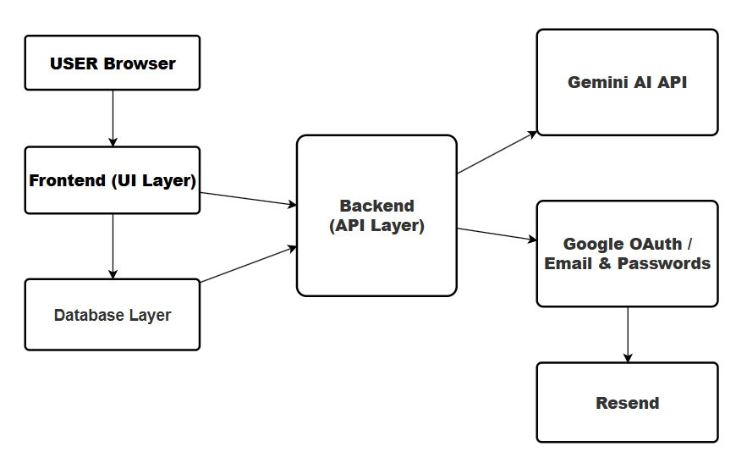
SYSTEM ARCHITECTURE

Slide 5
PROPOSED SYSTEM
Approach to Solving the Problem
Develop a secure, AI-enhanced platform to help users track, manage, and analyze personal finances. Use a responsive frontend with Next.js and shadcn/ui for a seamless multi-device experience. Implement a real-time, serverless backend using Supabase and Prisma for scalability and performance. Integrate Gemini AI for personalized insights and spending behavior predictions. Enable features like receipt uploads, automatic expense categorization, and email reports via Inngest and Resend.
Key Innovations / Improvements
AI-powered financial insights using Google Gemini
Receipt scanning with automatic categorization
Secure and simple authentication using Clerk
Event-based email reports (e.g., monthly summaries, alerts)
Clean, modern UI with Tailwind CSS and shadcn/ui
Real-time, serverless backend powered by Supabase

Slide 6
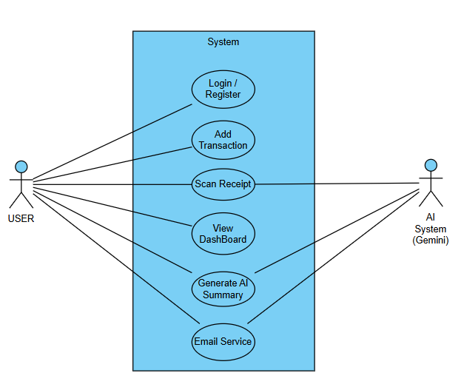
Use Case Diagram

Slide 7
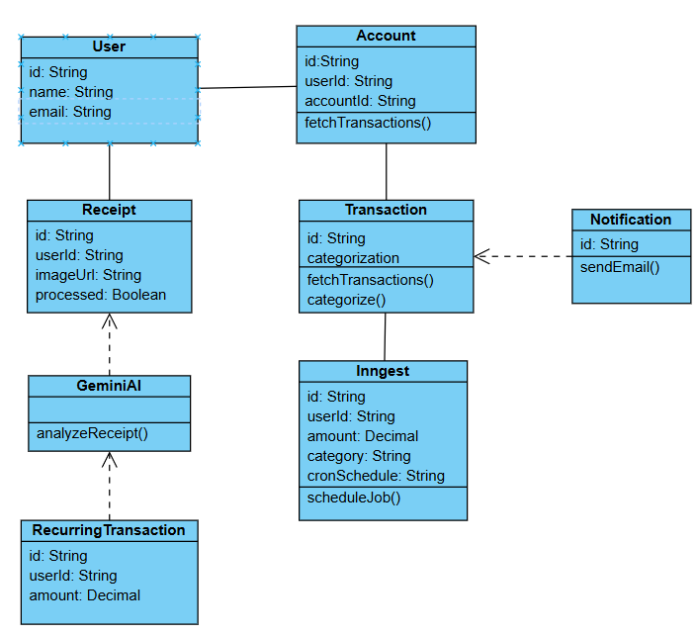
CLASS DIAGRAM:

Slide 8
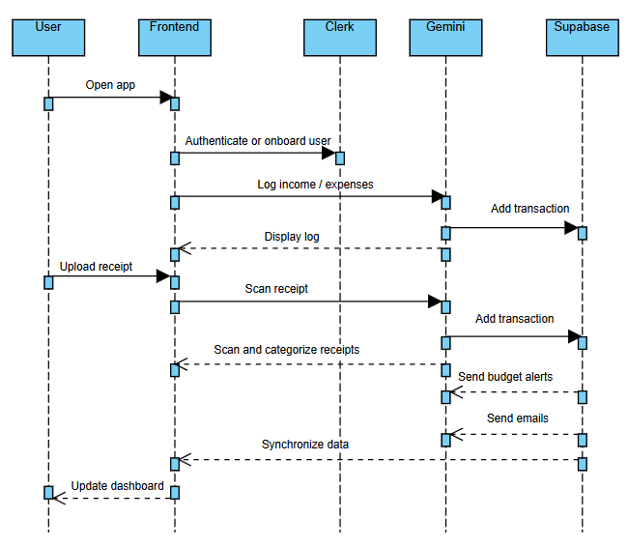
Sequence Diagram:

Slide 9
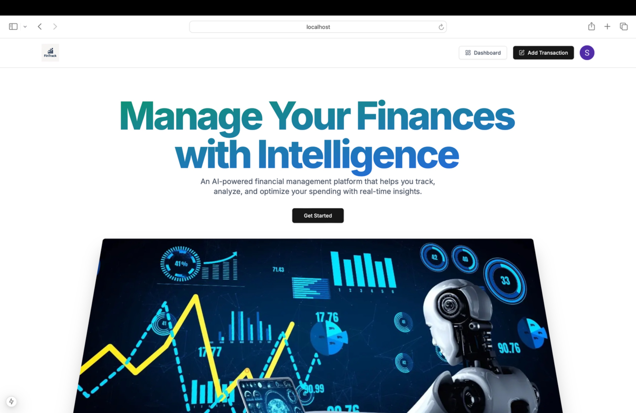
RESULTS:

Slide 10
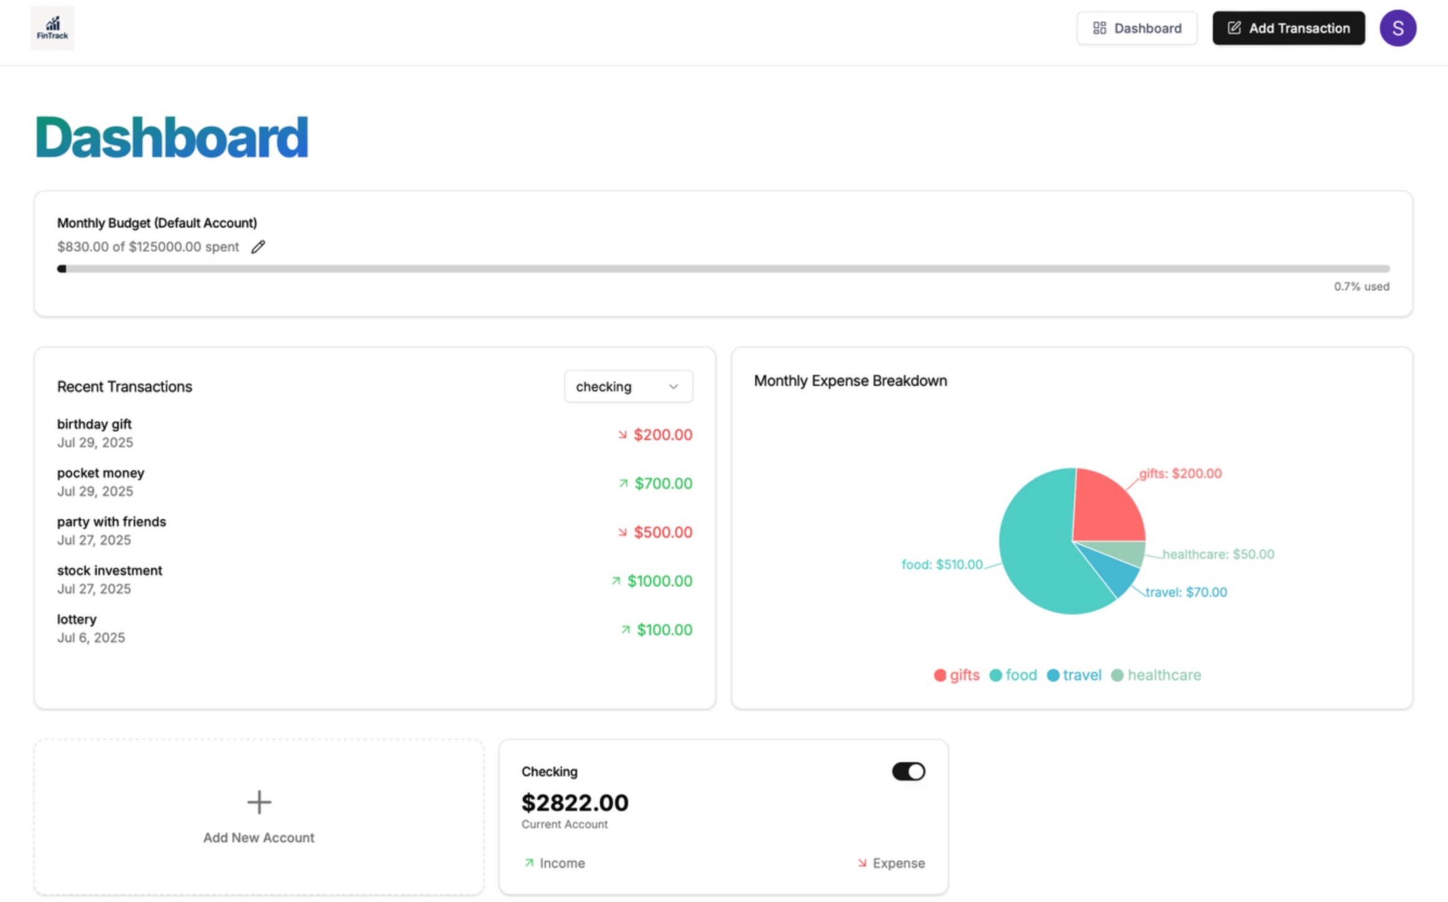

Slide 11
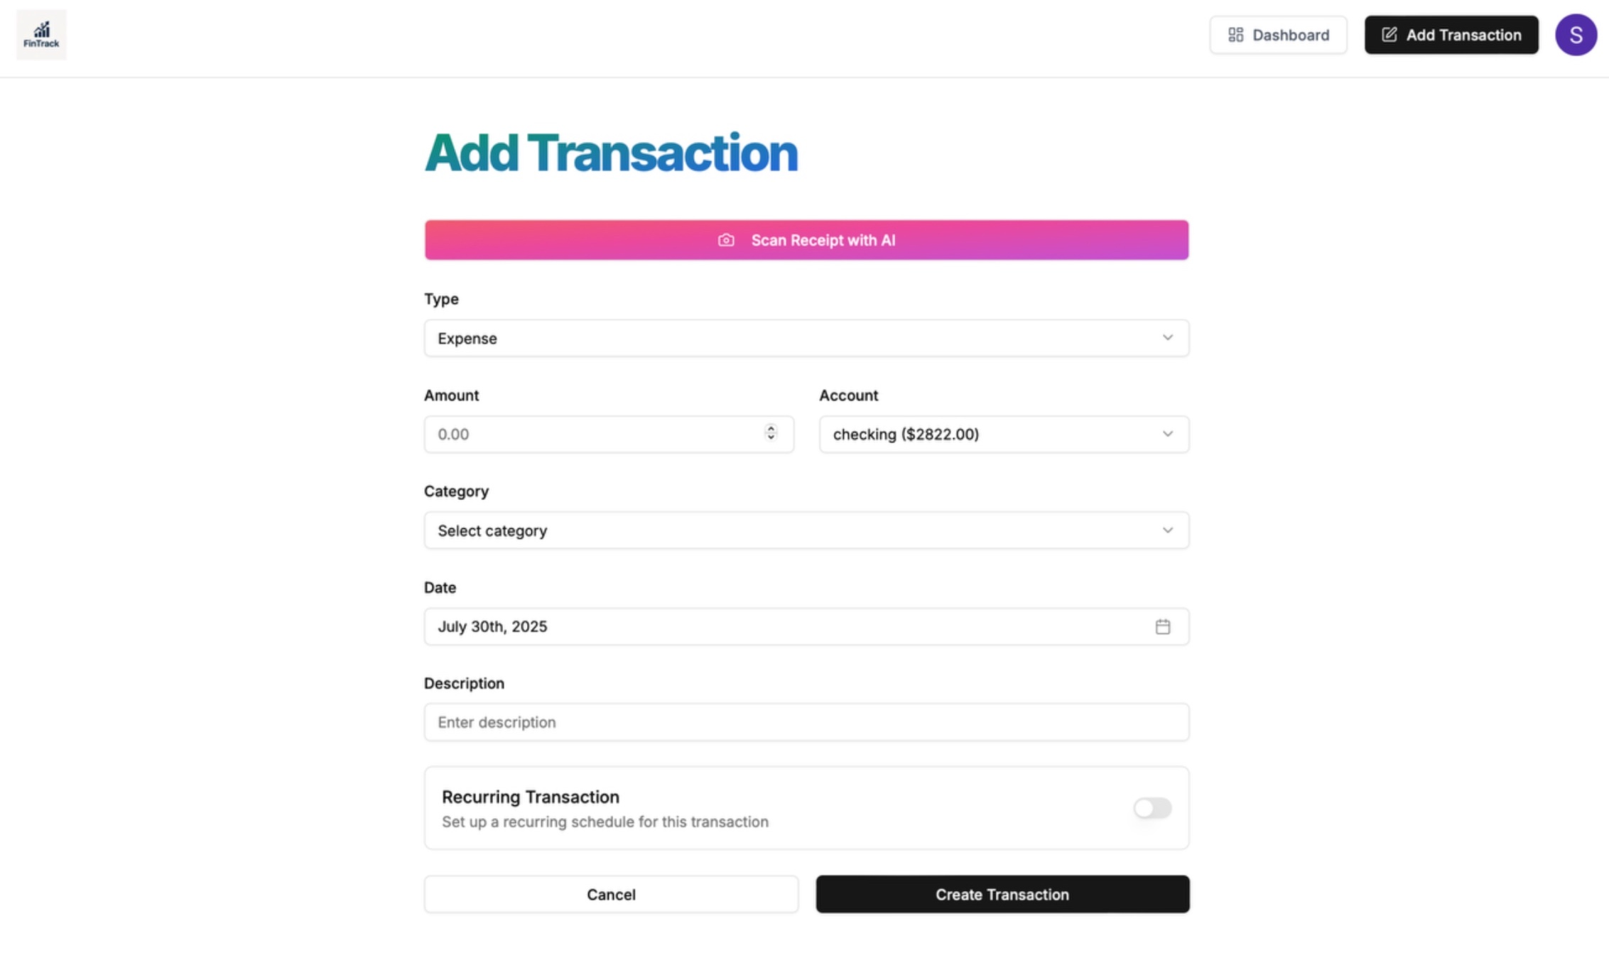

Slide 12
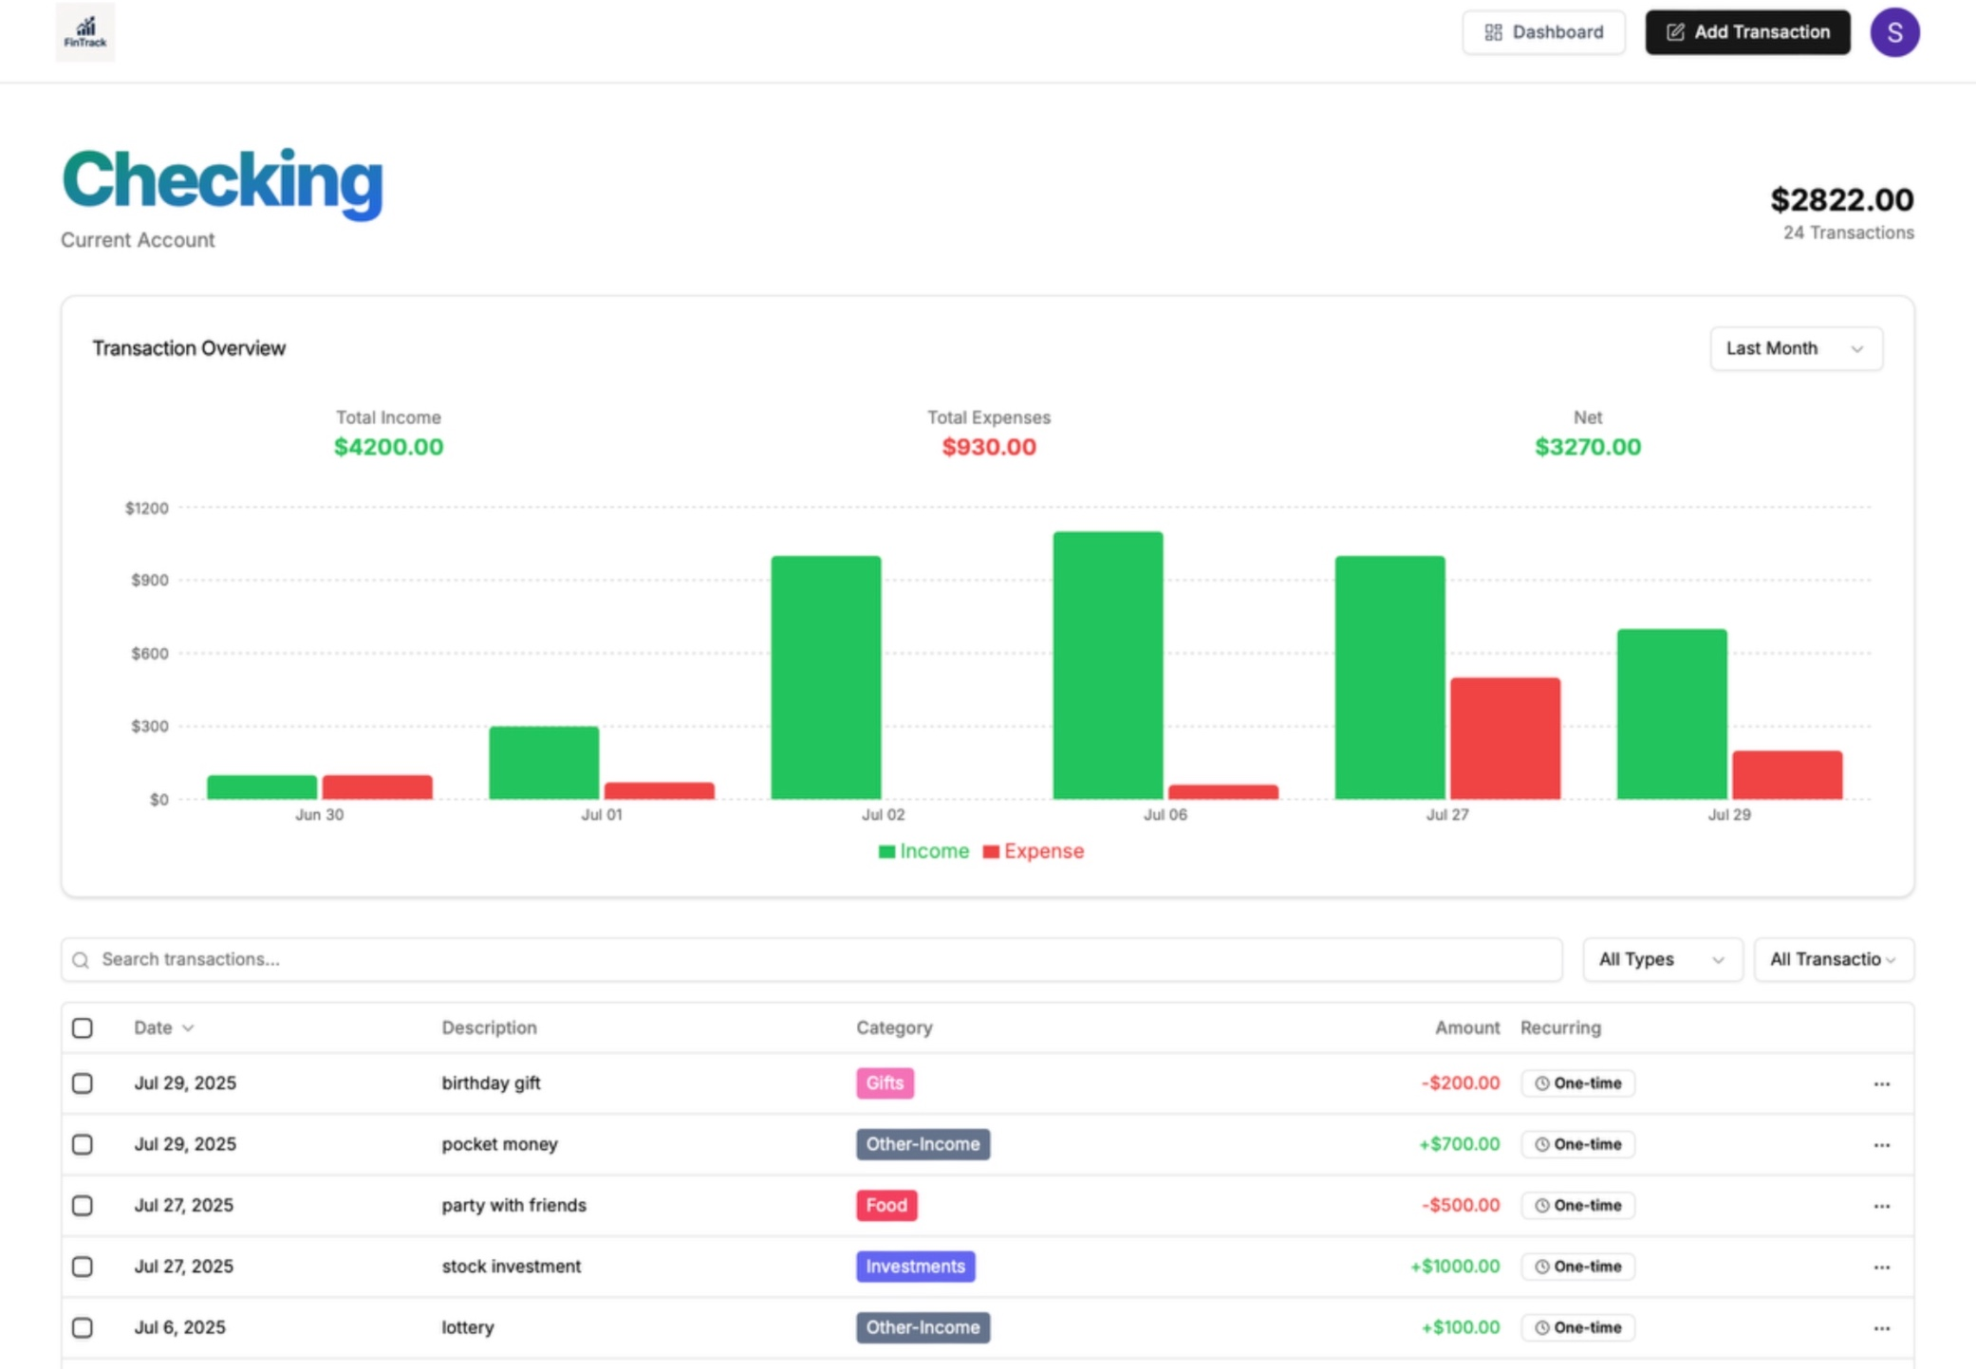

Slide 13
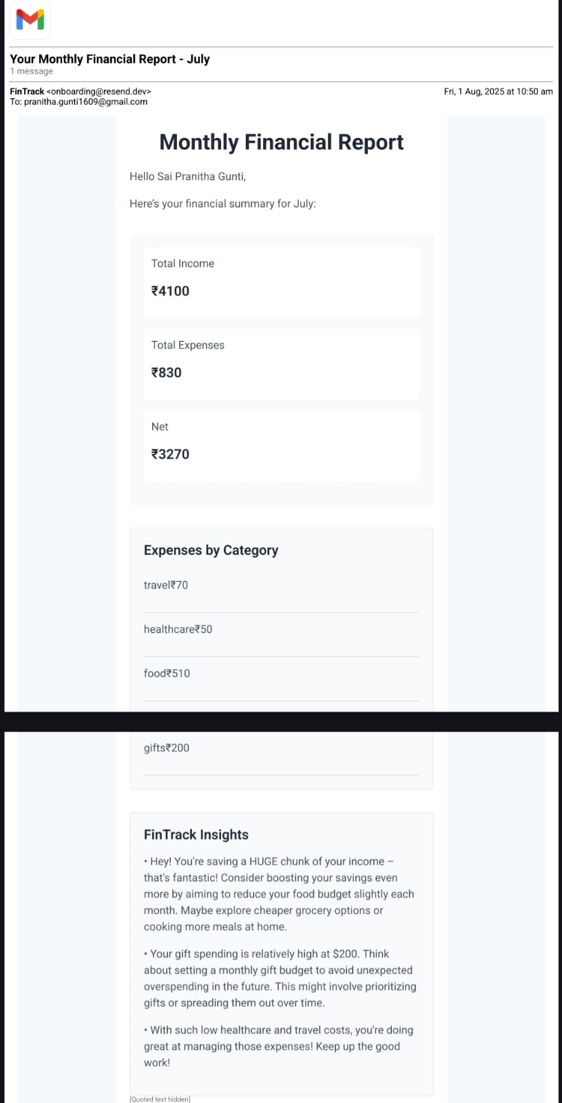

Slide 14
CONCLUSION
The AI Finance Platform is a smart financial management system that combines AI with modern web technologies. It simplifies expense tracking, budgeting, and reporting using tools like Next.js, React, PostgreSQL, and Gemini AI for features such as receipt scanning and auto-categorization.
The platform includes secure login, AI-assisted transaction management, multi-account support, and interactive dashboards with visual insights. It also offers features like budget alerts, real-time analytics, and automated email reports to improve financial decision-making.
Thorough testing ensures the system performs well under load while maintaining data security through encrypted passwords, JWT, and HTTPS. Overall, the platform makes finance management easier, more accurate, and smarter through AI-powered automation.

Slide 15
FUTURE IMPROVEMENTS
8.1 Mobile App Version To enhance accessibility, a mobile version of the platform can be developed using React Native or Expo, which align closely with React/Next.js for easier implementation. The mobile app can reuse much of the existing UI and logic, enabling users to manage their finances on the go. Additional features like push notifications for transaction alerts and budget reminders can improve user engagement.
8.2 NLP Features (Natural Language Processing) Integrating NLP can make user interaction more intuitive and efficient. By leveraging pre-trained models from Hugging Face Transformers, the app can allow users to ask financial queries in natural language. A simple classification model can also be trained to automatically categorize transaction descriptions into relevant types.
8.3 Machine Learning Enhancements Machine learning can bring predictive intelligence to the platform. Models like LSTM can be used to forecast future expenses based on past spending data. Additionally, the system can analyze seasonal spending patterns and provide tailored recommendations to help users make informed financial decisions.

Slide 16
ANY QUESTIONS????

Slide 17
THANK YOU

